Slide 1

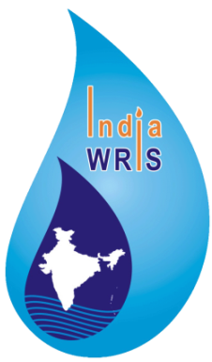


Ministry of Jal Shakti
Department of Water Resources, RD & GR
WIMS-Water Information Management System
National Hydrology Project

Slide 2

Training Session on WIMS
(Water Information Management System)
(Surface Water and Ground Water)
National Hydrological Project(NHP)
Topic : Overview of WIMS & Station Management in WIMS
Date : 18-April-2020
Venue: Online Webnair On Webex
Organised By : NPMU ,NHP, MOWR,TAMC,CWC
.

Slide 3
Trainer Name : Meet Kumar Agarwal
Designation : Test Lead
Department : TAMC- National Hydrological Project(NHP)
Email Id : agarwalmeet@rediffmail.com, meetk@tekskillsinc.net
Contact No : 9650866776

Slide 4
Welcome Note & WIMS Project Objective
.

Slide 5
OVERVIEW OF WIMS
WIMS - "Water Information Management System"
WIMS is a web-based open source software system for managing data entry, primary data validation, data processing, storage etc. for Surface Water and Ground Water Resources.
WIMS Software is an extension of eSWIS software.
In WIMS data is very much secure and only classified user can access the WIMS application.
In WIMS, we can manage and create both kind of station type .i.e. Surface Water and Ground Water
WIMS stores all the information of station for both station type (Surface Water and Ground Water) on basis of agencies.

Slide 6
Advantages of WIMS Software-
User Management Module is most important module and it can be manage by their Nodal Agency in WIMS.
All kind of station can be created from one place under station management
In WIMS Software, Ground Water module functionality is implemented and Ground Water station data can feed from Ground Water Module. But earlier Ground water module functionality feature was not present in eSWIS software
Live data from INSAT & GPRS is managing from various telemetric stations and reservoir stations in WIMS under Telemetry Management
Water Quality Module will be integrated for Surface Water and Ground Water in WIM
Flood Forecast Module is more simpler for data entry and different reports can be generated related to Flood Forecast

Slide 7
Training Modules of WIMS(Surface Water/Ground Water)-
Station Management -
a) Search Station
b) Add Station( Manual Station, Telemetric Station/Reservoir Station)
c) Edit Station
Data View-Telemetry
Manual Data Entry
Data Validation
User Management
Create User /Edit User
Create Role/Edit Role
Telemetry Management
Sensor Hub Configuration / Reservoir Sensor Hub Configuration)
a)Add Data Logger Id b)Add Sensor Configuration (INSAT/GPRS)
c)Edit Sensor Configuration
Import Tool & Reports
Reduced Level of zero of the Gauge , X-section, & Current Meter
Flood Forecast Module
Questions and Answers with Feedback

Slide 8
Links-
Live Application URL : www.indiawris.gov.in
WIMS Live URL: tamcnhp.com/wims/
WIMS Training URL : stg.tamcnhp.com/wims/
Training Environment Login Credentials –
Login Id: Training
Password : Test#12345

Slide 9
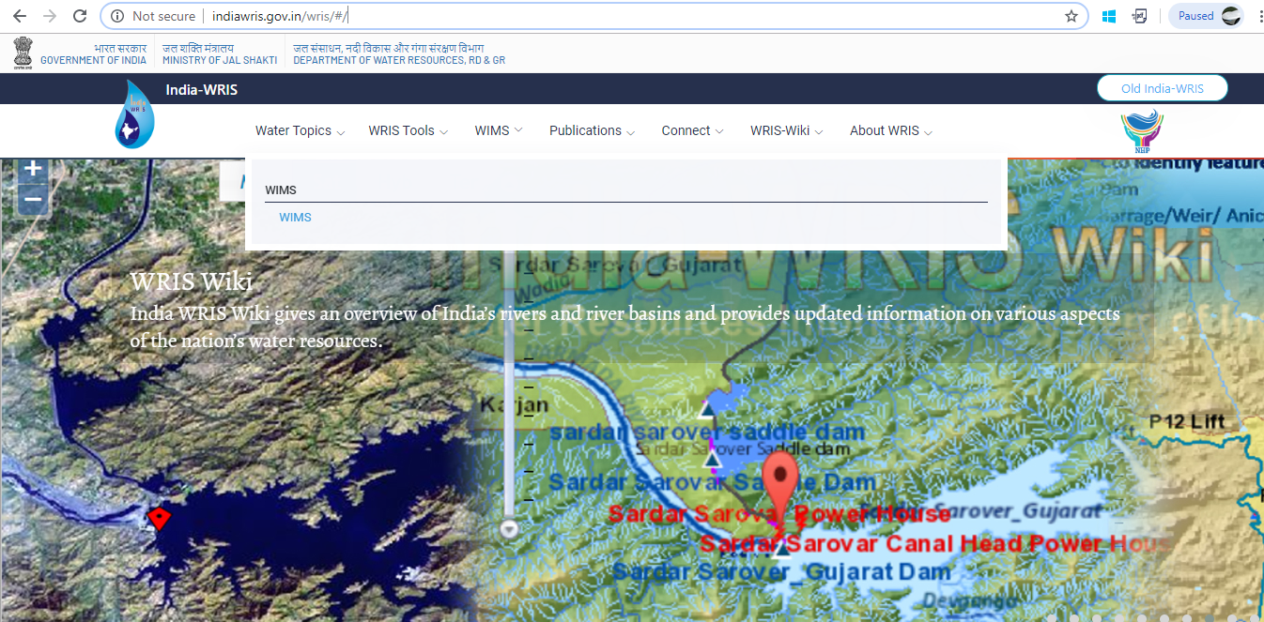
Login into WIMS(Water Information Management System)
1.Open the Production URL http://indiawris.gov.in/wris/ in any web browser.
Go “WIMS” menu and Click on “ WIMS” Hyperlink

Slide 10
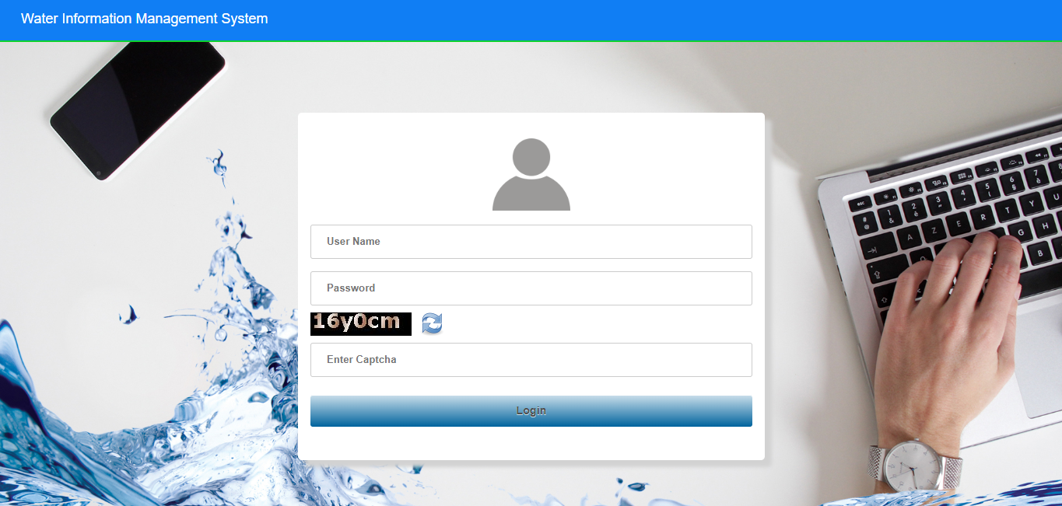
Login screen will display on the user’s screen.

Slide 11
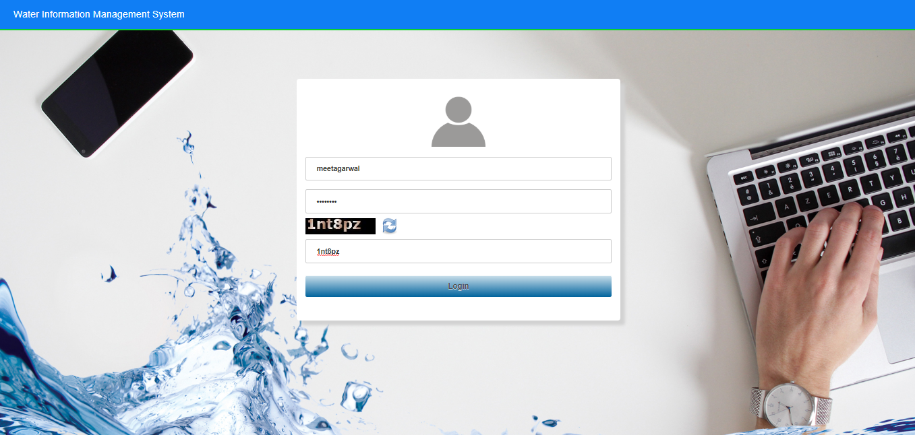
2. Enter Login ,Password & Captcha details based on the User Agency. Click on Login button.

Slide 12
3. Enter Login, Password & Captcha details based on the User Agency.
- Click on Login button

Slide 13
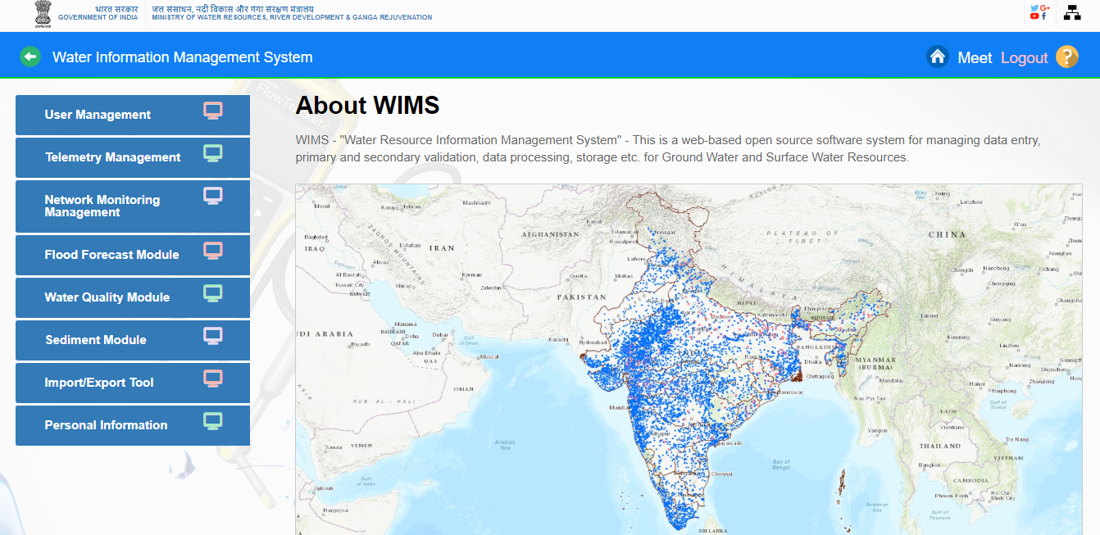
4. A brief description About WIMS is displayed with Surface Water /Ground Water Stations maps in India.
5. Home page of WIMS will be displayed on screen after login into WIMS application. User once done with the work can logout the session using the Logout Icon on the right top corner. Home Icon is to navigate back to the main page from sub modules page

Slide 14
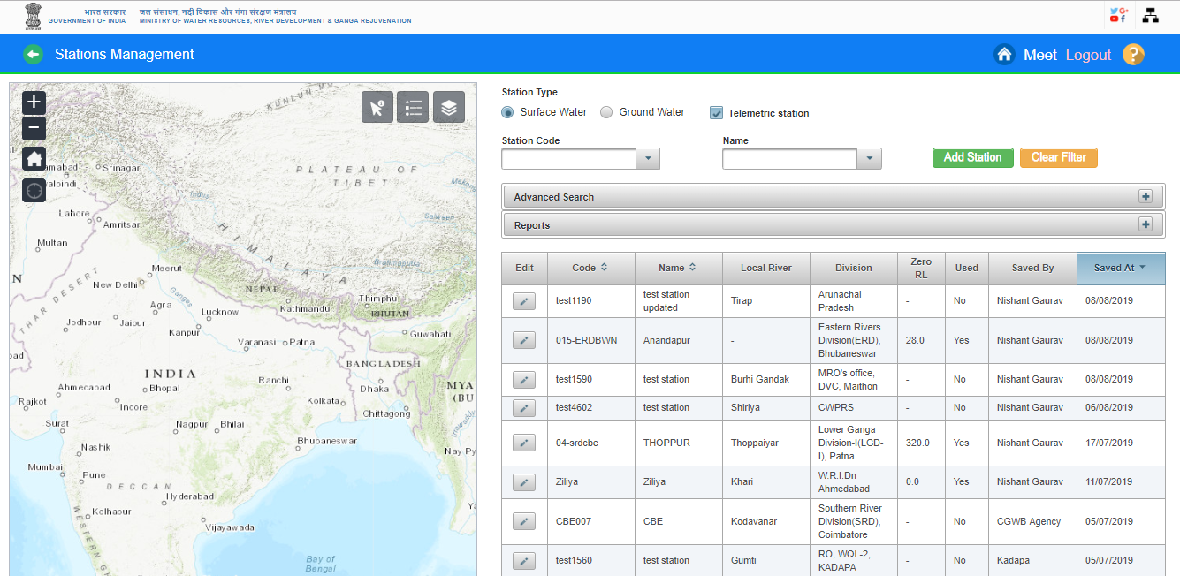
Station Management
Station Management is one of the most important module in in WIMS. Stations are mapped with their corresponding agency with agency hierarchy in WIMS Database and stations are listed as per station type ie. Surface Water or Ground Water as per the agency wise. Many important attributes to each observational station can be assigned for defining its location in terms of geographical, administrative or drainage units and for indicating various offices which have control on its operations. Locational attributes are important for the purpose of finding inter station distances and difference in altitudes for the purpose of data processing.

Slide 15
Station Code
Station identification code is to be assigned to every station. This is the most important field of the database since most of the information in the database is associated with the observational stations and these stations are identified by this code. Two stations can not have identical station identification code in WIMS. The database is provided with in-built facility to ensure uniqueness of the station code for integrity of the database. The station code one assigned cannot be changed at later stage.
Station Name
The station name is the full name of the observational station assigned by the agency for purpose of addressing it for all common uses. Generally, the station name is given on the basis of name of Local River, village, town etc. together with some reference of nearby structure, institution etc. and thus is comparatively longer. There is possibility of having two or more observational stations with the same station name within a large region. Though, identical station names do not cause any problem with respect to data integrity with in the database but it is always advisable to avoid such situations. The station name is associated with station code.But it is advisable. Kindly do not add the duplicate station name in WIMS

Slide 16
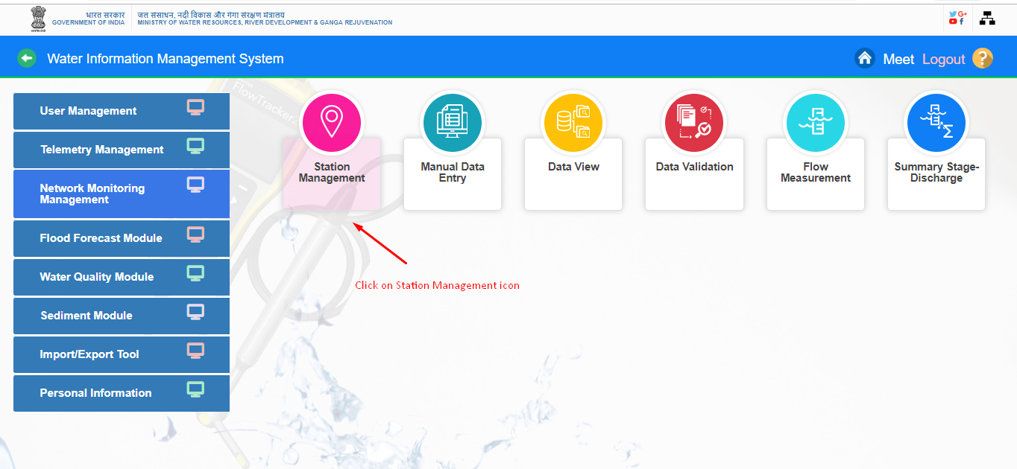
Search the station in WIMS-
Go under “Network Monitoring Management “ Module , then Click on “Station Management “icon

Slide 17
-Select “Station Type” (Surface Water/Ground Water ) Radio Button
- Click on ““Telemetric Station” Checkbox on “Station Management” page

Slide 18
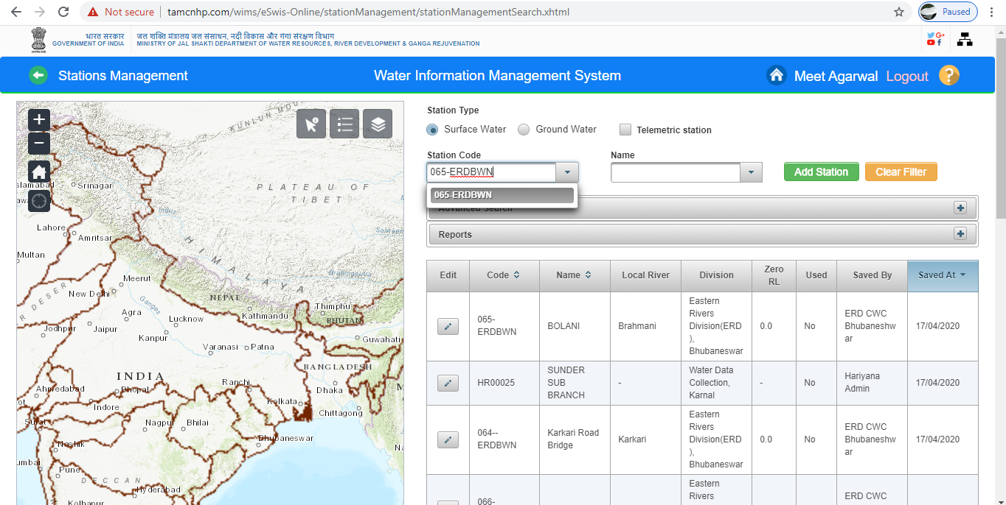
Note -You have to enter minimum 3 digits/ characters for searching the Station Code and Station Name.
Search by Station Code: Enter the given station code or Name For Example- Enter “Station Code” 065-ERDBWN in Input field.

Slide 19
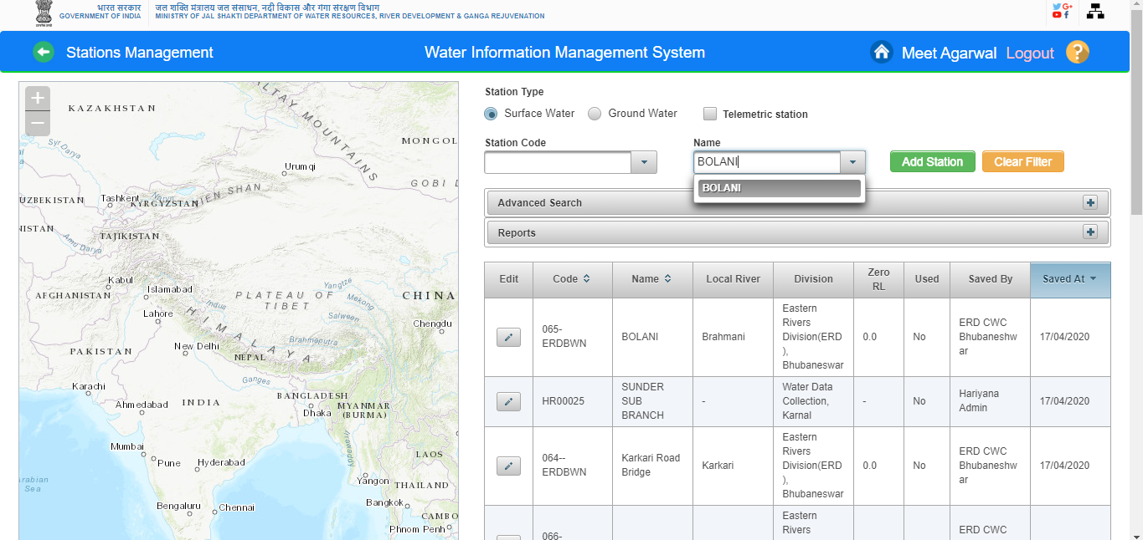
Search by Station Name :Enter the station name at least 3 characters “ BOLANI”. Station Name will be search associated station code is also display of that station

Slide 20
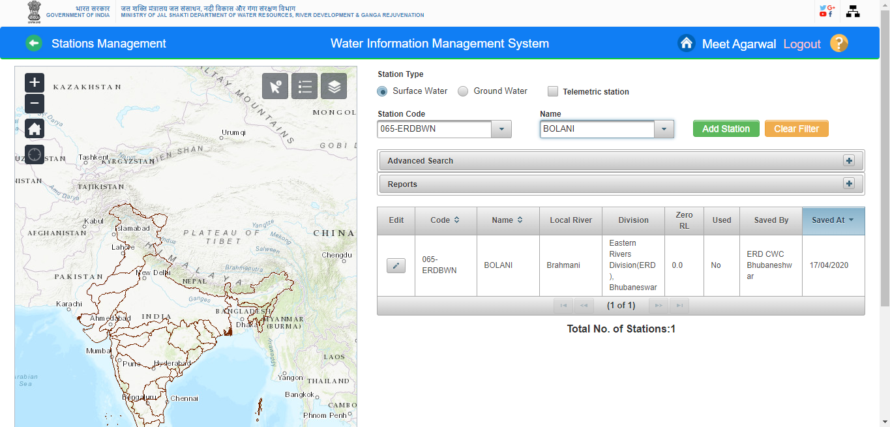
Station code and Name is displayed in Station Data Table on station management page

Slide 21
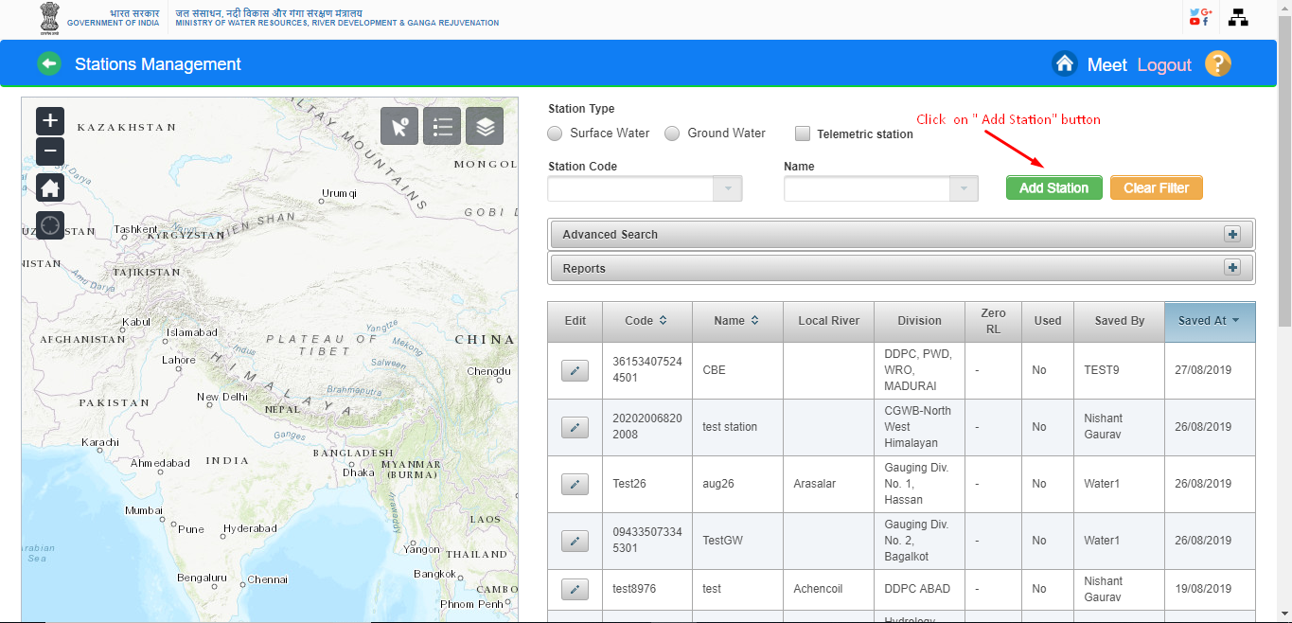
ADD NEW STATION(Surface Water or Grounder Water) – Nodal Agency has to add the station details for both type of stations ( Surface Water and Ground Water) from Station Management section in WIMS Software
Surface Water Station-You can create Surface Water stations (Manual Station/ Telemetric Station/ Reservoir Station /Flood forecast Stations/Weather Stations) from Station Management section. 1. Click on “ Add Station” button

Slide 22
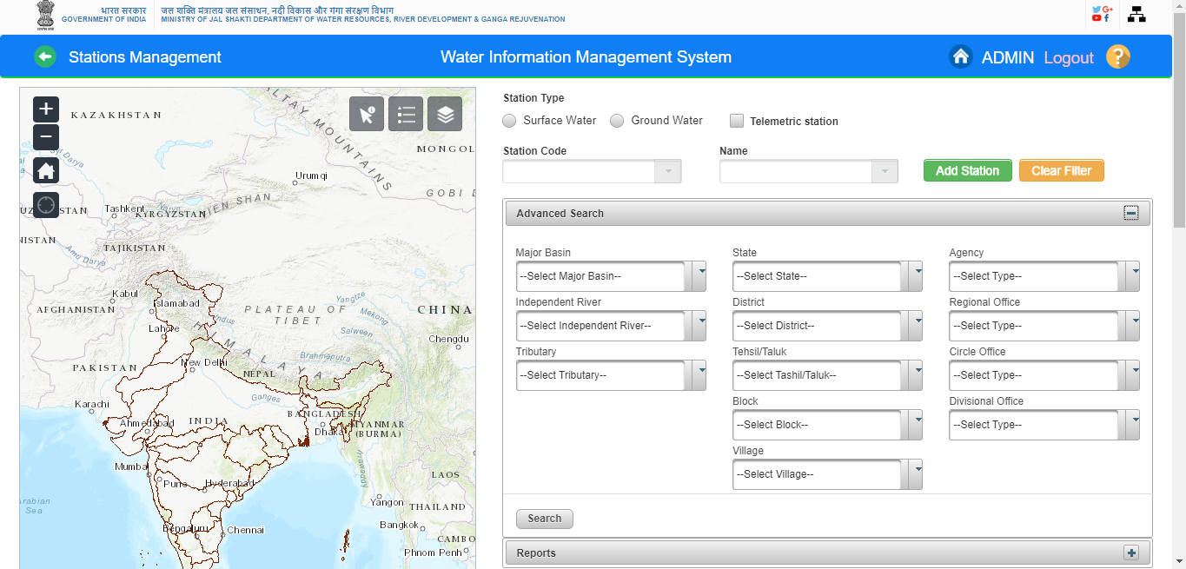
Advanced Search Option – You can do advanced Search of both Station type (Surface Water/Ground Water/ Telemetric) on basis of Major Basin, State or Agency Wise search criteria.

Slide 23
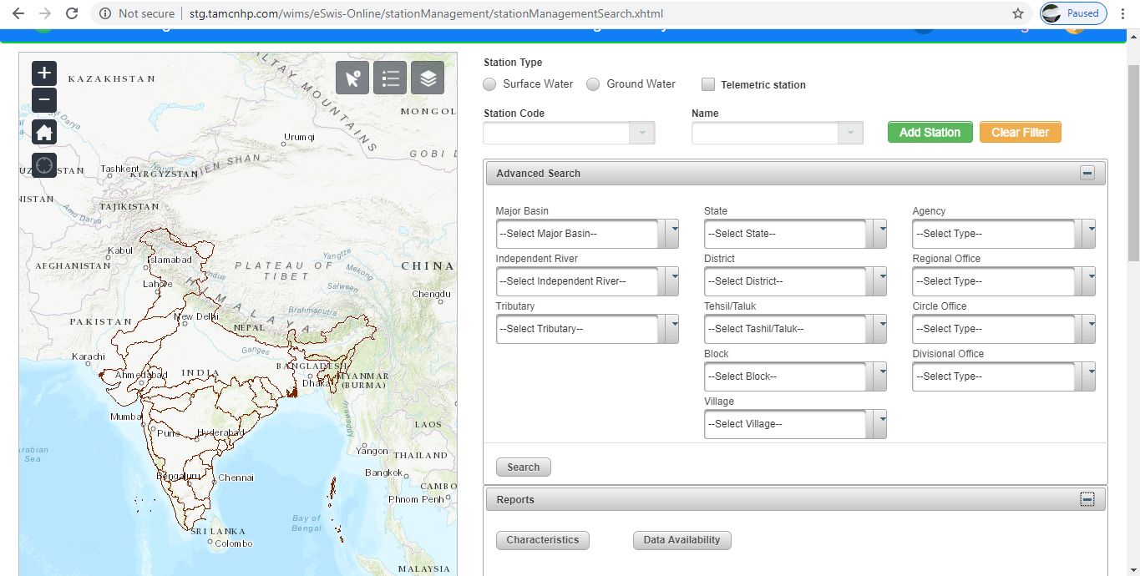
Reports-
Station Characteristics
Data Availability

Slide 24
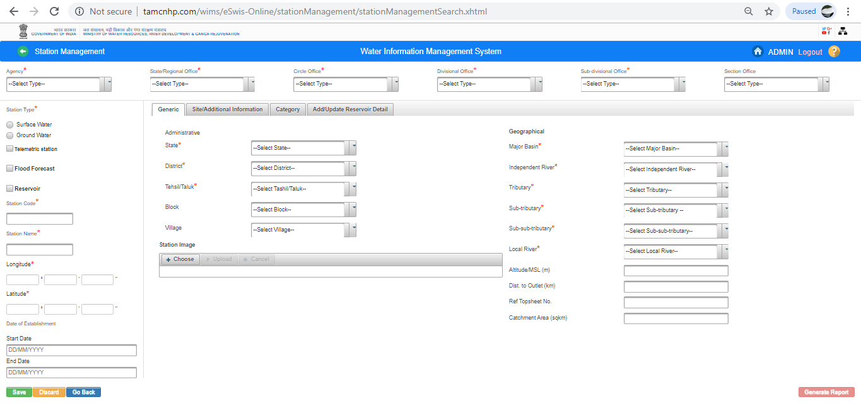
2. Station Characteristics page is opened on screen. You have to add all mandatory field details for adding new station from this page

Slide 25

3. Add Agency details. Select the agency and all other mandatory fields for example - State/Regional Office, Circle Office, Divisional Office, Sub-divisional Office, Section Office fields from respective dropdown list which need to enter for creation of particular station
4. Select Station Type ( Surface Water or Ground Water) as per the available details of Station configuration on the respective agency.

Slide 26
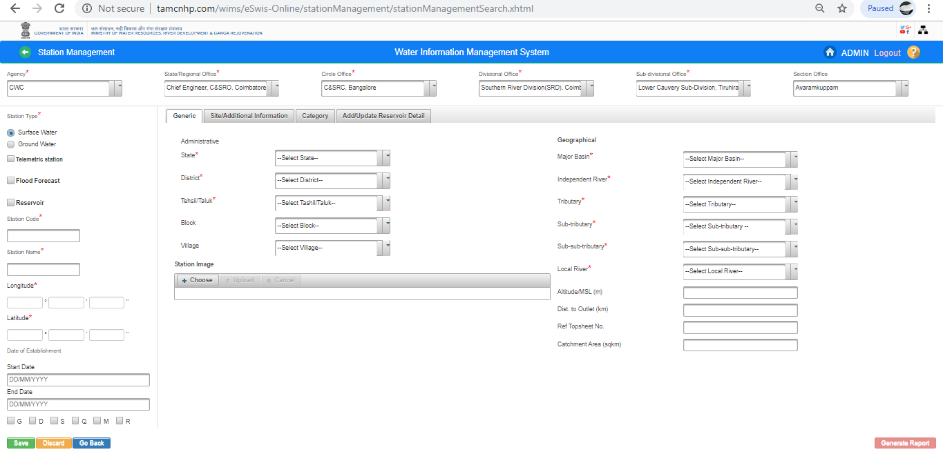
5. Select Type of station which you want to create ( Telemetry Station or Reservoir or Flood Forecast or Manual) Page in Station Management

Slide 27
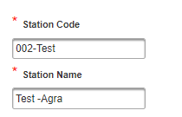
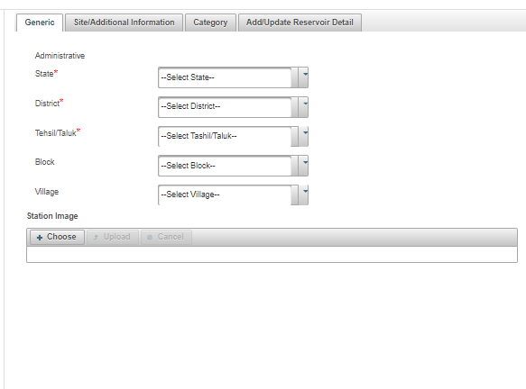
6. Enter New “ Station Code and “ Station Name” which is get from the available details list for adding the new station in WIMS
7. Fill all administrative details for example - Select State, District & Tehsil/Taluk from “ Administrative” under “Generic” Tab for Surface Water.

Slide 28
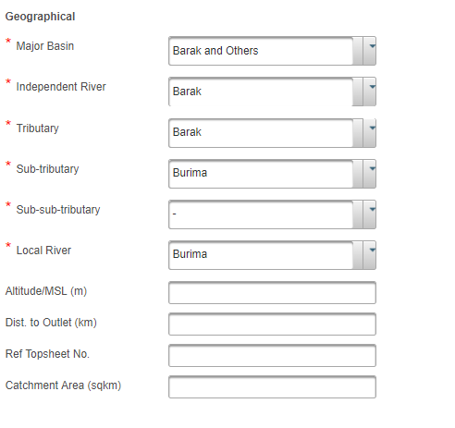
8. Add “ Geographical” mandatory details and fill all the mandatory fields and necessary fields values under “Geographical” section

Slide 29
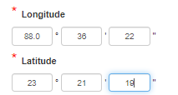
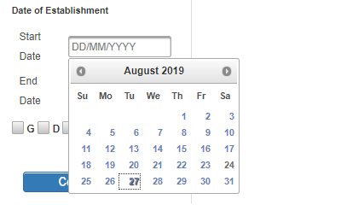
9. Add “Longitude” and “Latitude” details
10.Select or Enter “ Date of Establishment” of Start Date and End Date

Slide 30
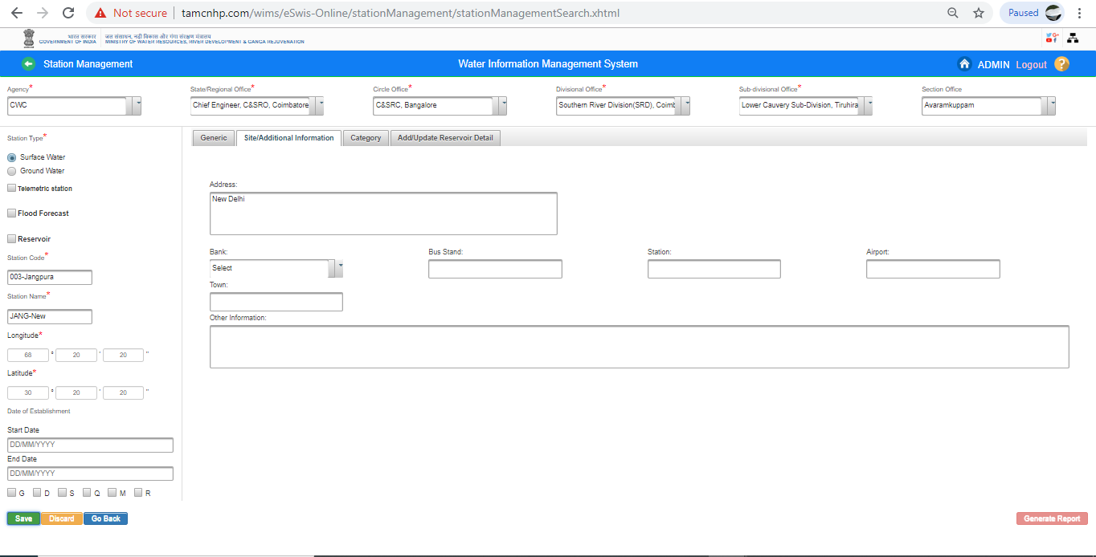
11. “ Add Address “ from “ Site & Additional Tab” on “Add Station” Page under Station Management

Slide 31
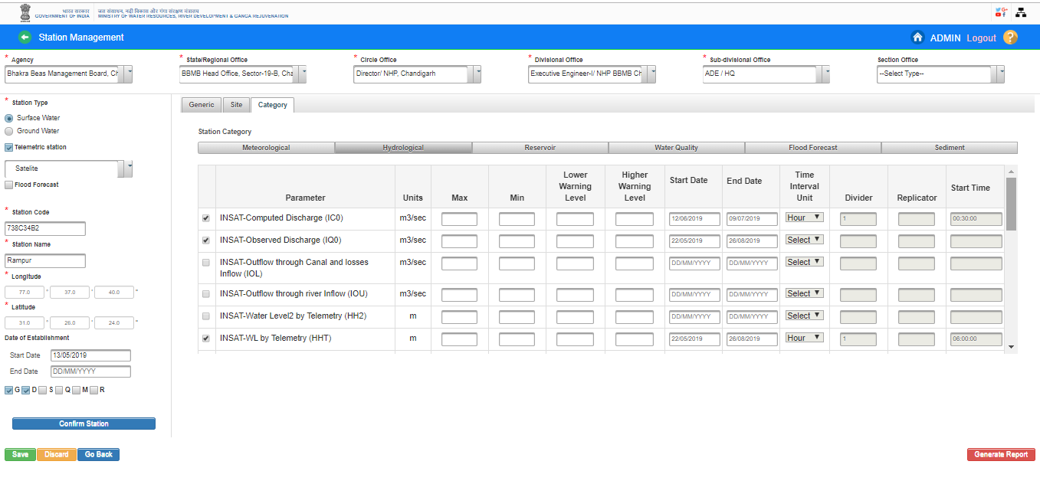
Add Data Type-
Click on “Category “ Tab and Select the respective “Category” from this section, User Agency can add “Sensors” or “Data Type” details as per the available details for sensors against the particular station at the time of station configuration or after adding the station as well.

Slide 32
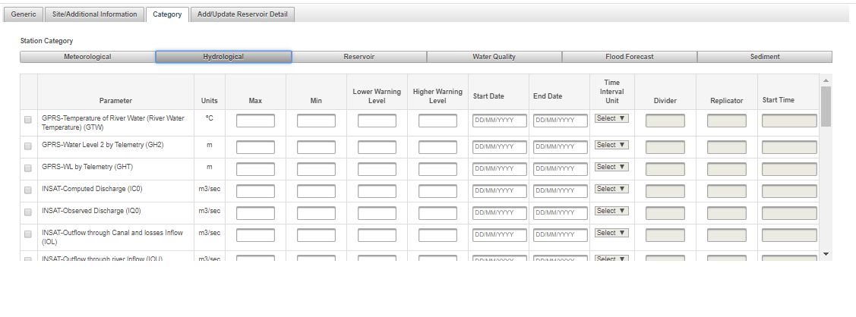
Agency can add/edit the “Lower Warning Level “and “Higher Warning Level” from the “Category Section
Agency has to click on the check box for adding the sensors /data type details to particular station in case of adding new station or existing stations. It is mandatory to add the sensors details otherwise sensors or data type will not be listed in telemetric management under Sensor Hub Configuration section

Slide 33
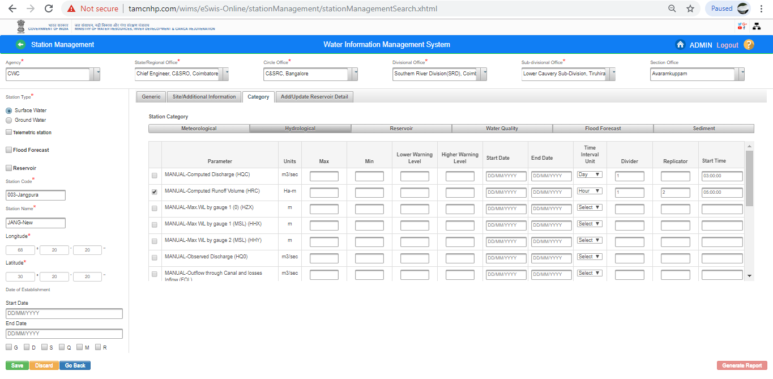
Save Station Characteristics Details: Click on “ Save” button. Station information will be saved in WIMS application and Pop up message will be displayed on screen “Station has been saved successfully”

Slide 34
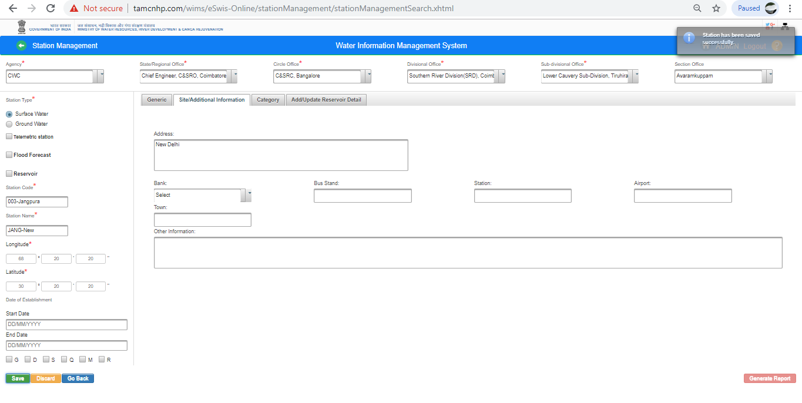

Slide 35
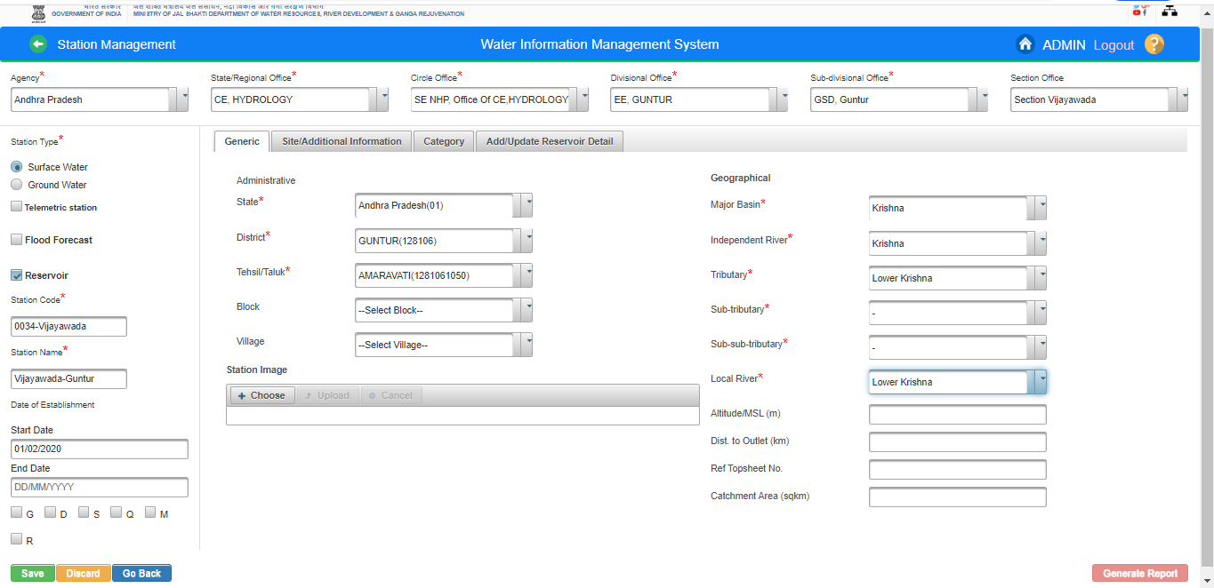
Add Reservoir Station- Click on Add Station Button .
- Fill Agency Meta data , Station Type, Generic & Administrative Detail
- Click on Reservoir Check Box and Enter the Station Code/Name, Date of Establishment

Slide 36
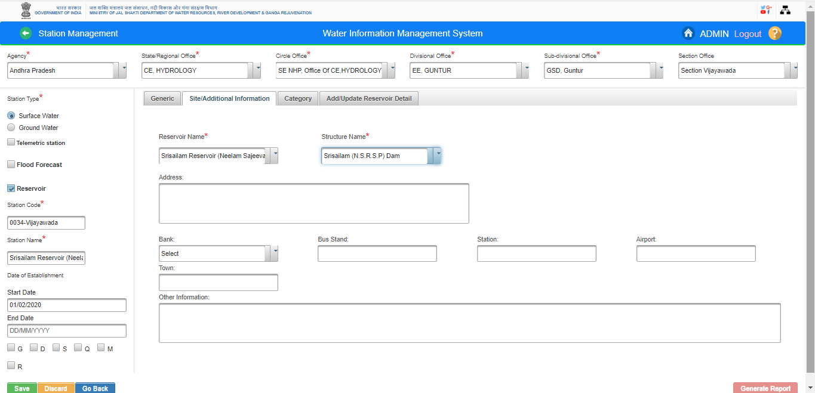
- Select Site/Additional Information Tab
- Select Reservoir Name and Structure Name under Site/Additional Information Tab

Slide 37
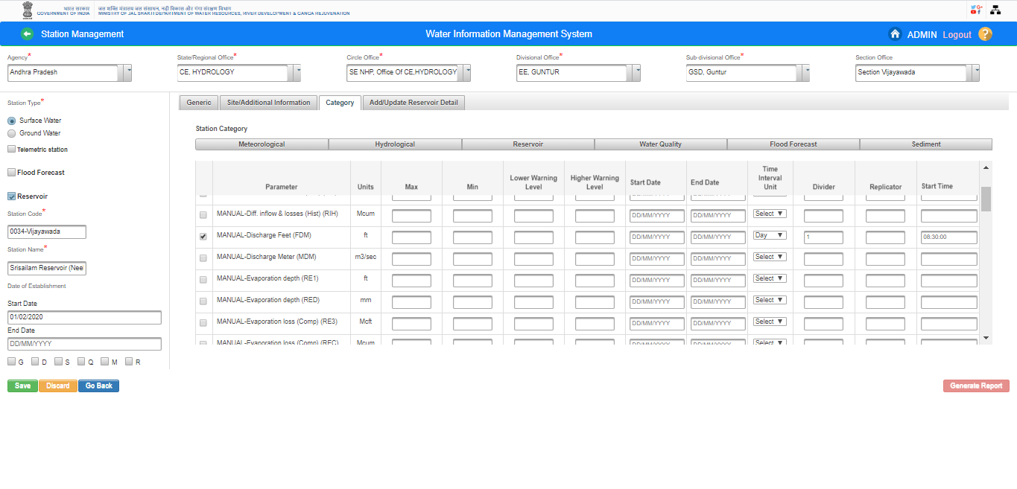
- Select “Category” Tab
- Select the Category Name

Slide 38
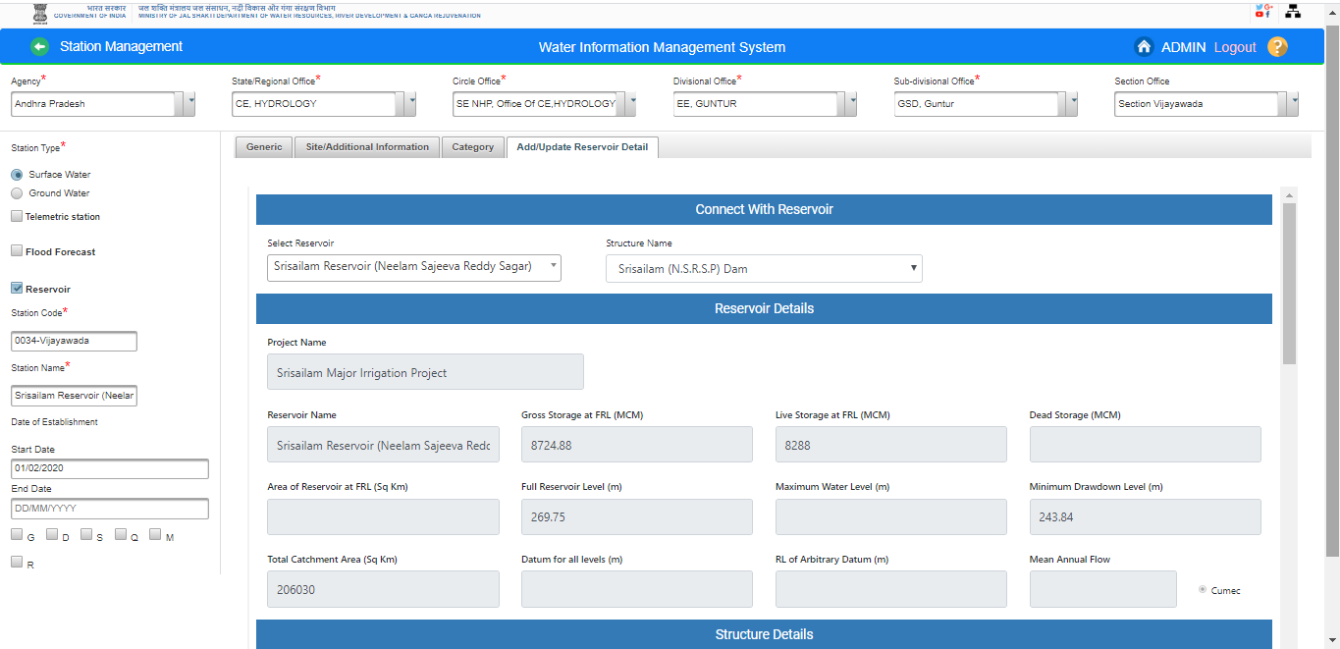
-Click on Add/Update Reservoir Detail Tab.
- Select Reservoir and Structure Name

Slide 39
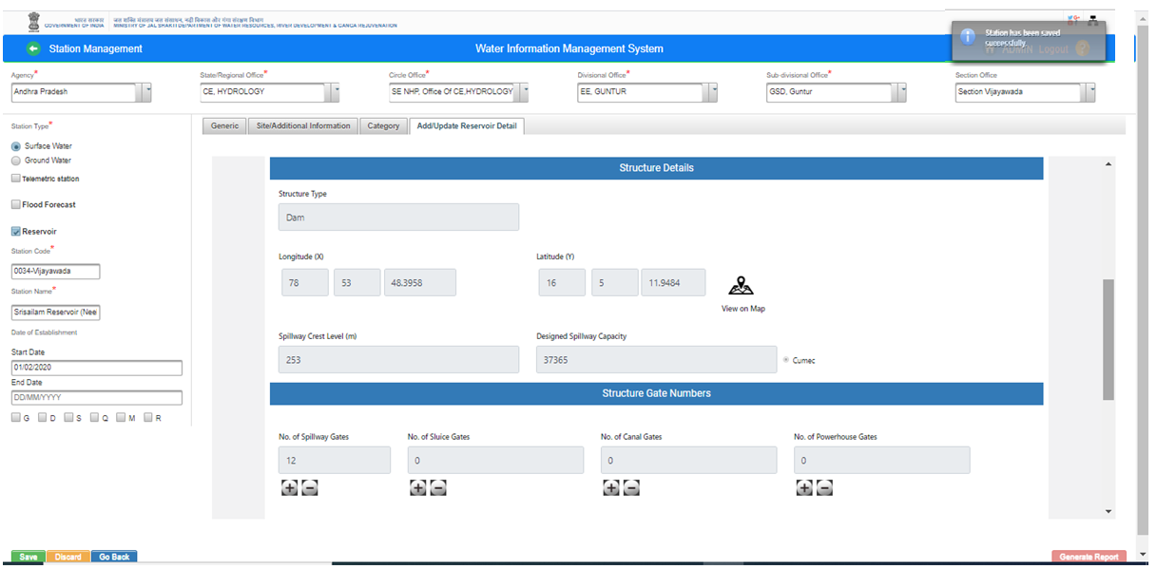
Click on Save button. Reservoir Station will be saved

Slide 40
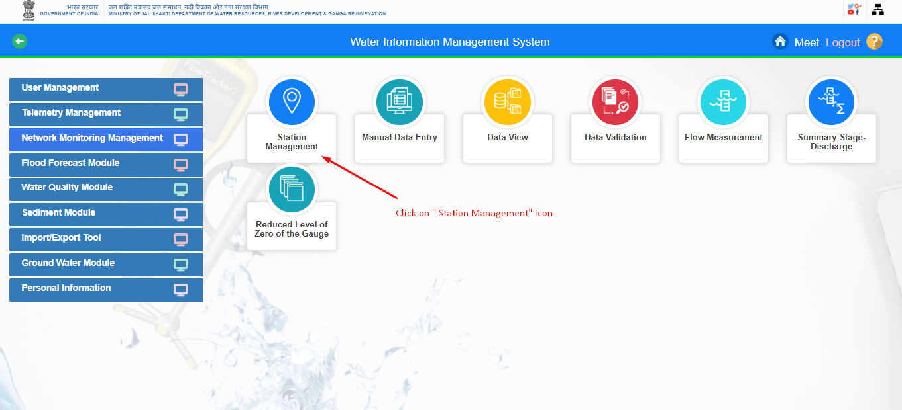
Ground Water Station-You can add Ground Water stations (Manual Station/ Telemetric Station) from Station Management section.
1. Click on “ Station Management” button.

Slide 41
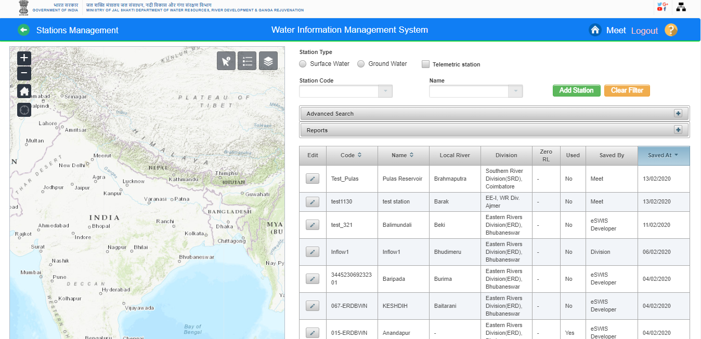
Station Management Page is open.

Slide 42
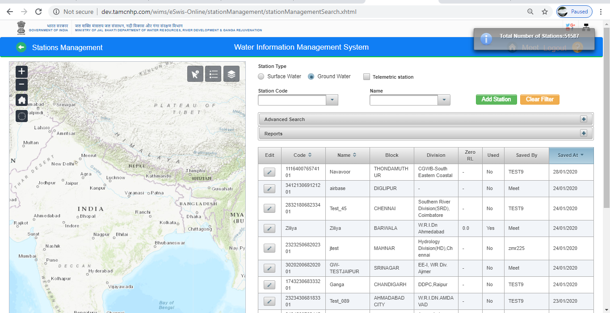
- Click on “Ground Station “ Station” button. Total Number of Ground Station will be displayed on Screen
- Add Station & Clear Filter buttons are shown
- Search & Advanced Search option is displayed on Screen

Slide 43
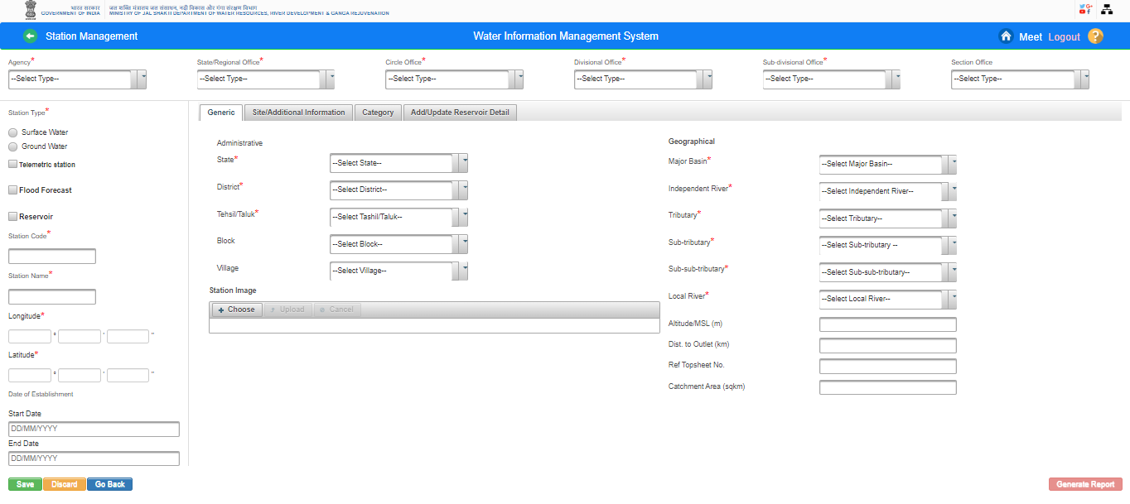
Create New Ground Water Station:
-Click on “ Add Station” button. Station Characteristics Page is displayed on screen

Slide 44
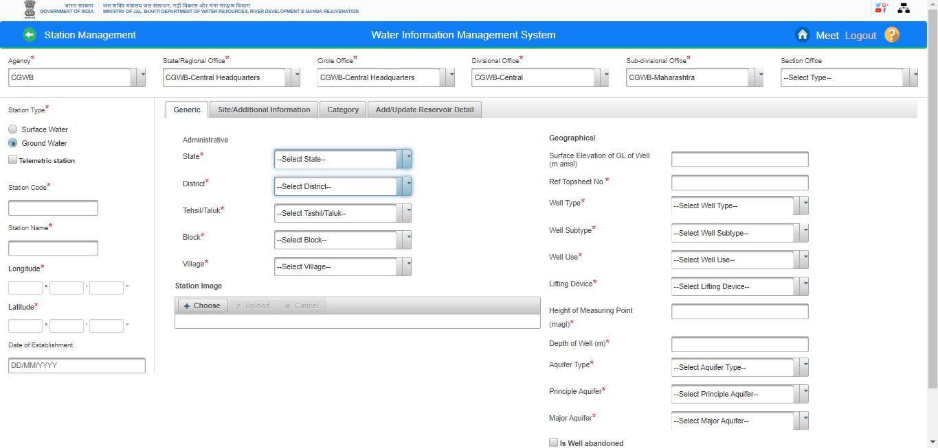
- Add Agency details (Agency Name, State /Regional Office, Circle Office, Divisional Office, Sub-divisional Office, & Section Office)
- Click Station Type as “ Ground Water “ and select the respective radio button

Slide 45
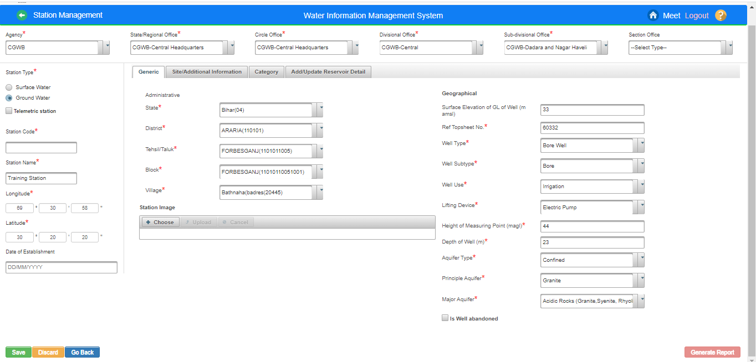
Fill all the mandatory input fields like Station Name, Generic Information(Administrative & Geographical both)

Slide 46
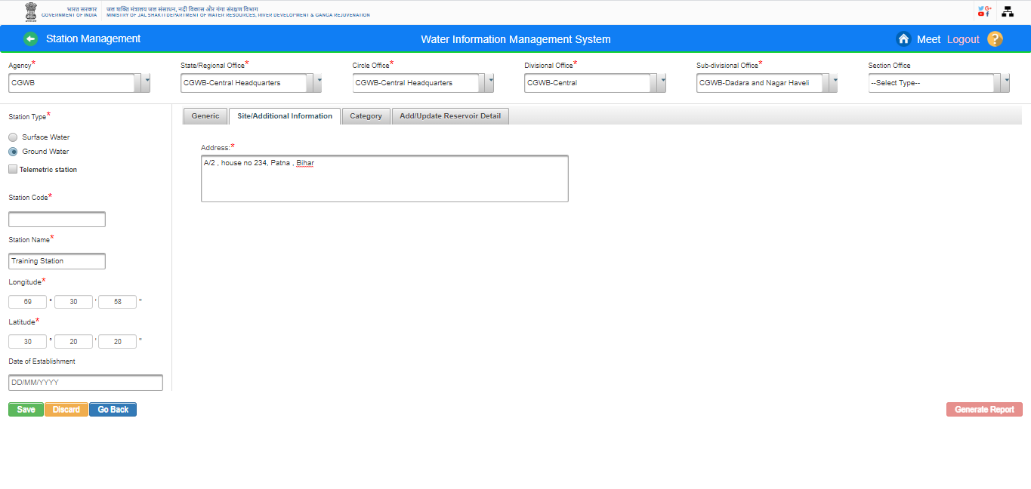
-Add Address under Site / Additional Information Tab for Ground water Station

Slide 47
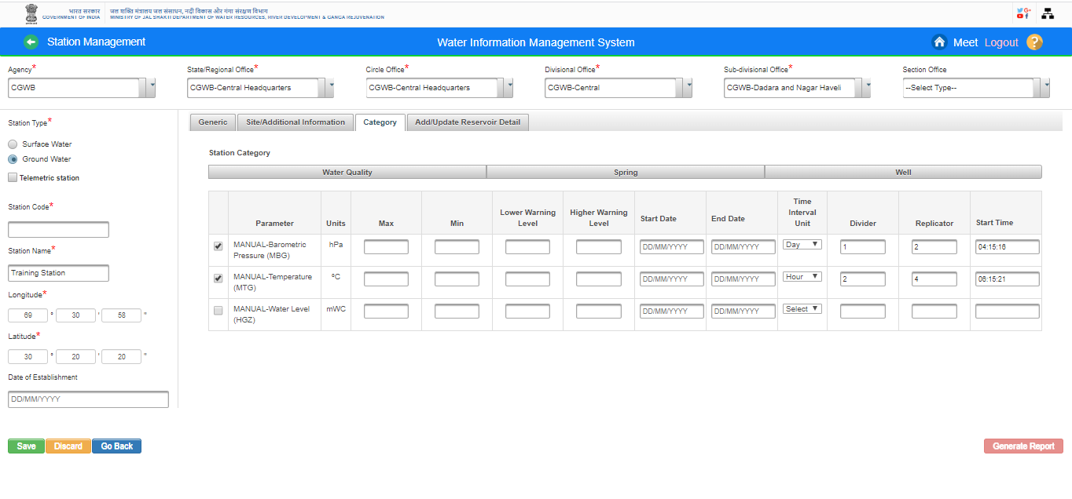
- Add data type for Category of Ground Water Station

Slide 48
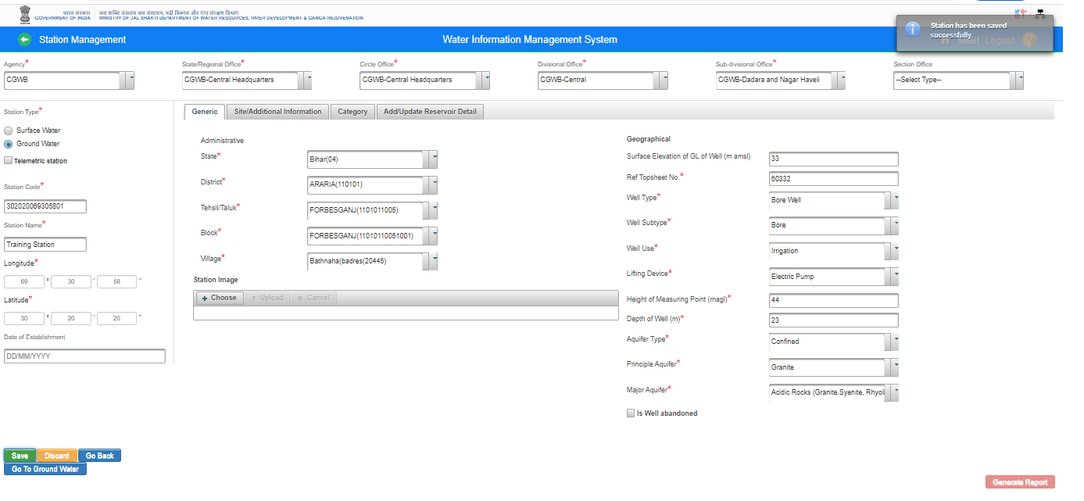
- Click on “Save” button. Ground Water Station will Saved Successfully

Slide 49
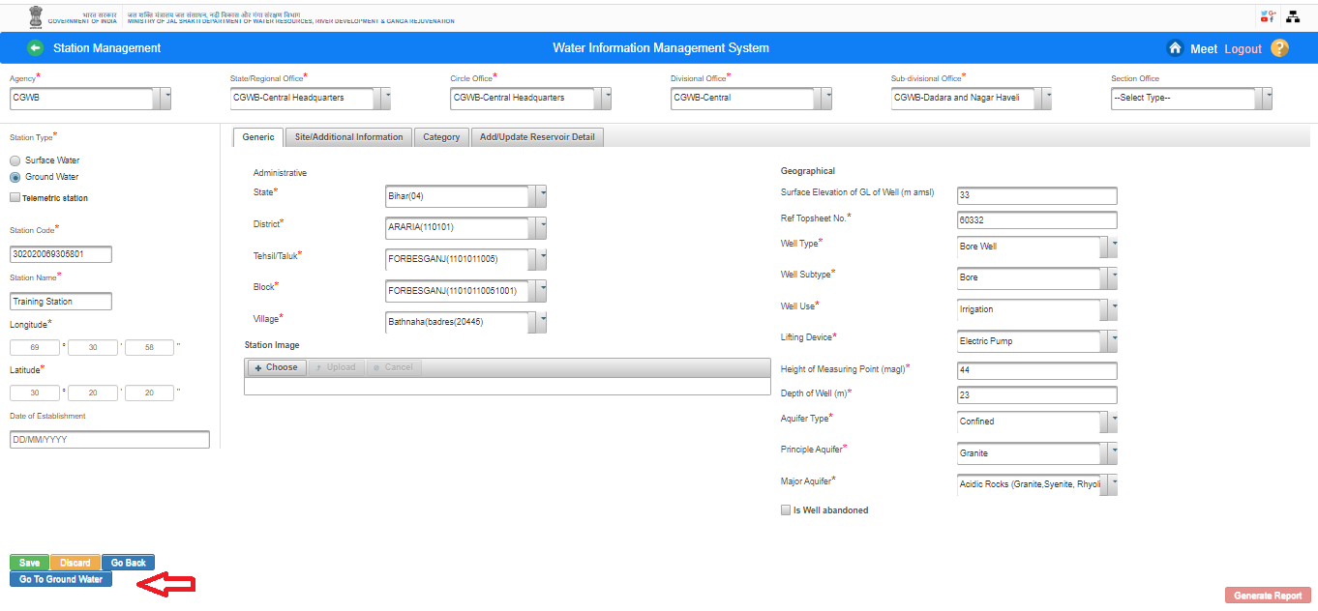
-Click on “ Go To Ground Water” button. Ground Water Module landing page opens and user can feed all the information of Ground Water Stations

Slide 50
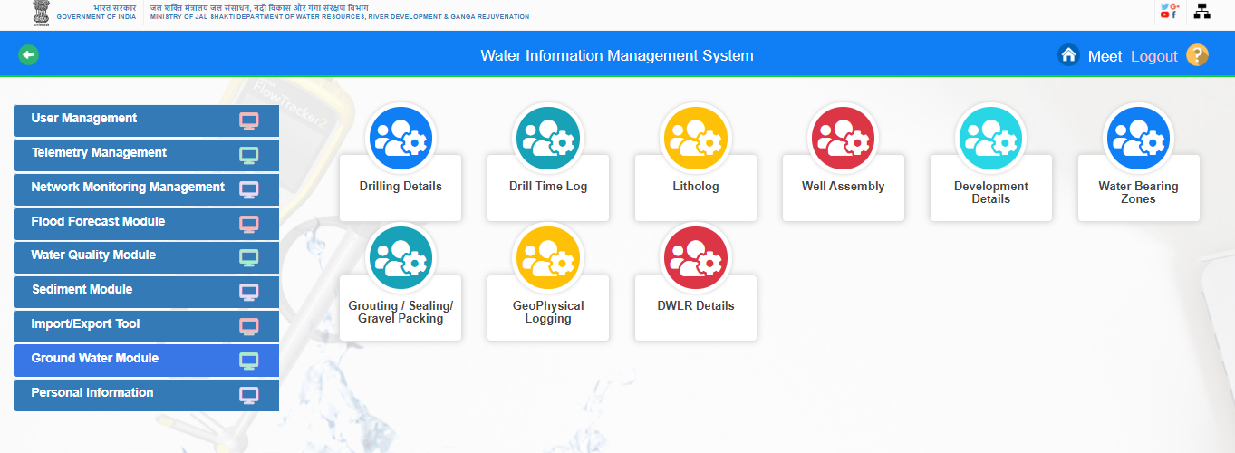
feed the ground water stations information using the respective forms(Drilling Details, Drill Time Log, Litholog, Well Assembly, Development Details, Water Bearing Zones, Grouting/Sealing /Gravel Packaging , Geo Physical Logging & DWLR Details

Slide 51
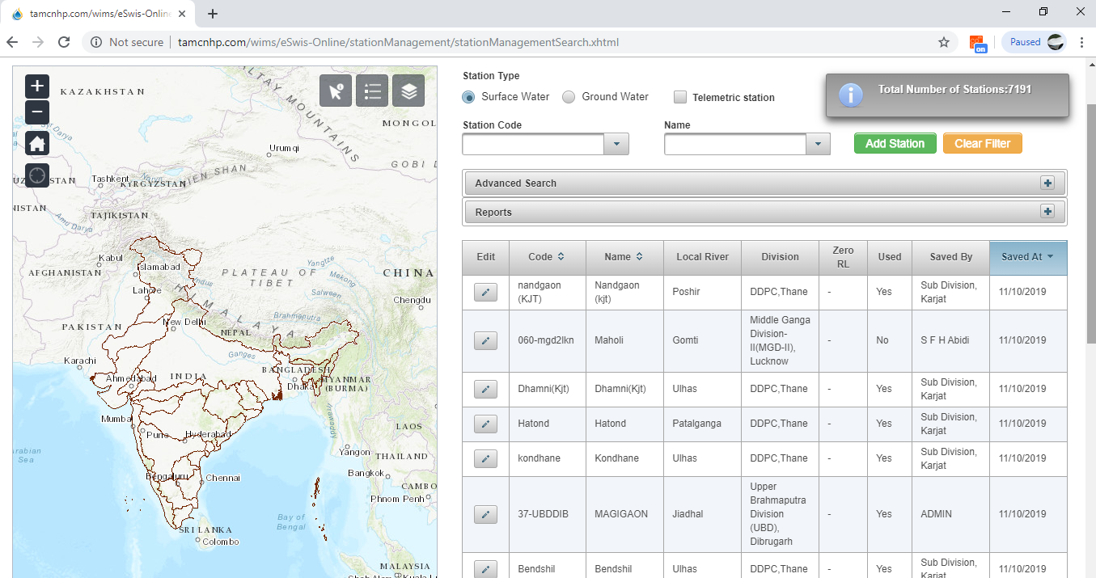
EDIT STATION (Surface Water/Ground Water):
Click on “Edit” icon in listed Station under station management table

Slide 52
You can edit the field details and click Save button to update the Surface Water /Ground Water station details

Slide 53
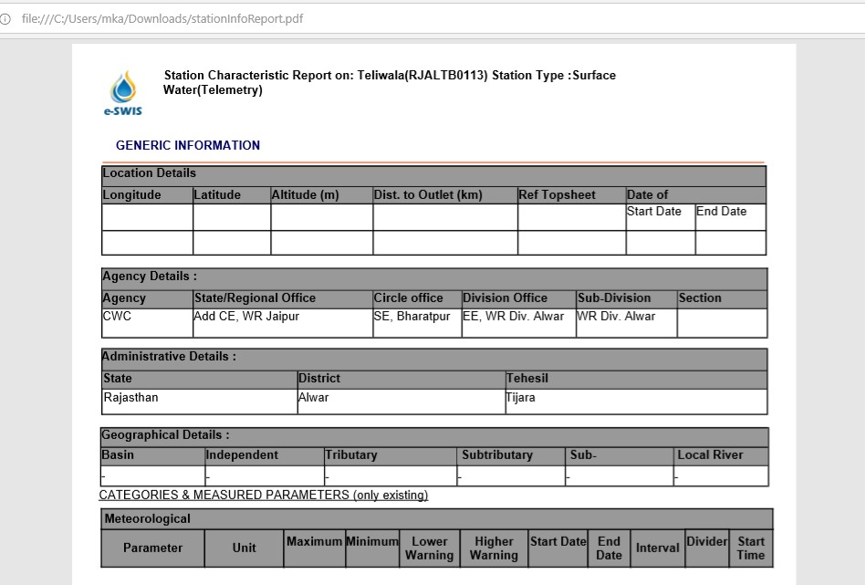
Generate Reports - If user wishes to get details about the Station as a report, then click on Generate Report button on the lower right on station page. A report will be generated as shown in Figure

Slide 54
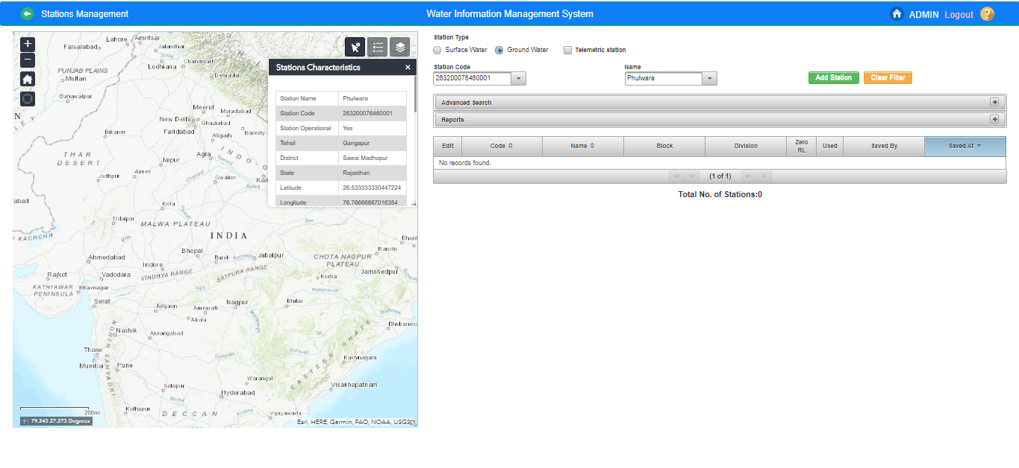
Select Station from Map
In case, user wants to Select Station from Map Section : -Visualize the layer list using Layer List Tool in the Map Section.Surface water /Ground Water stations are available on the map along with CWC basins and Subbasin Boundary. o To Identify Station Type- Surface water / Ground Water Legend Tool is provided in the Map Section. The user need to zoom to a scale where the points become visible on the map, then corresponding legend will appear in the Legend Window. oNavigate to the required station by zooming and panning on the map. oUse icon on the map section top right and click on the station on Map Based on the station selected filters Station Name and Station Code will be filled in the form automatically.

Slide 55
Questions and Answers with Feedback

Slide 56
THANK YOU

